Slide 1
Volatility forecasting with Gaussian HMM
Dziugas Chvoinikov

Slide 2

Goal: forecast H-day future volatility
Estimate:
Predict regime: High or Low

Slide 3
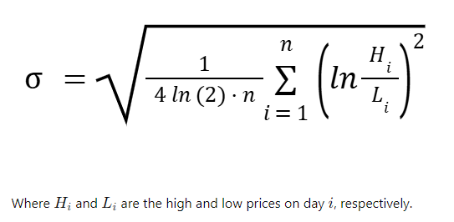
Daily variance proxy

Slide 4
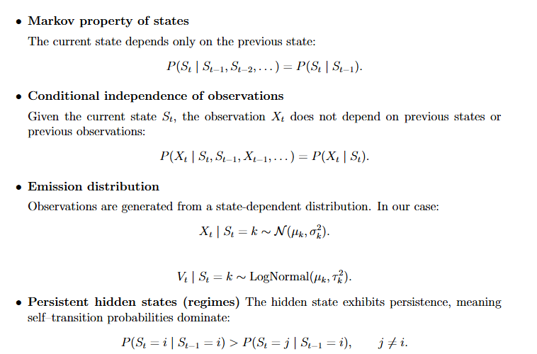
HMM key assumptions

Slide 5
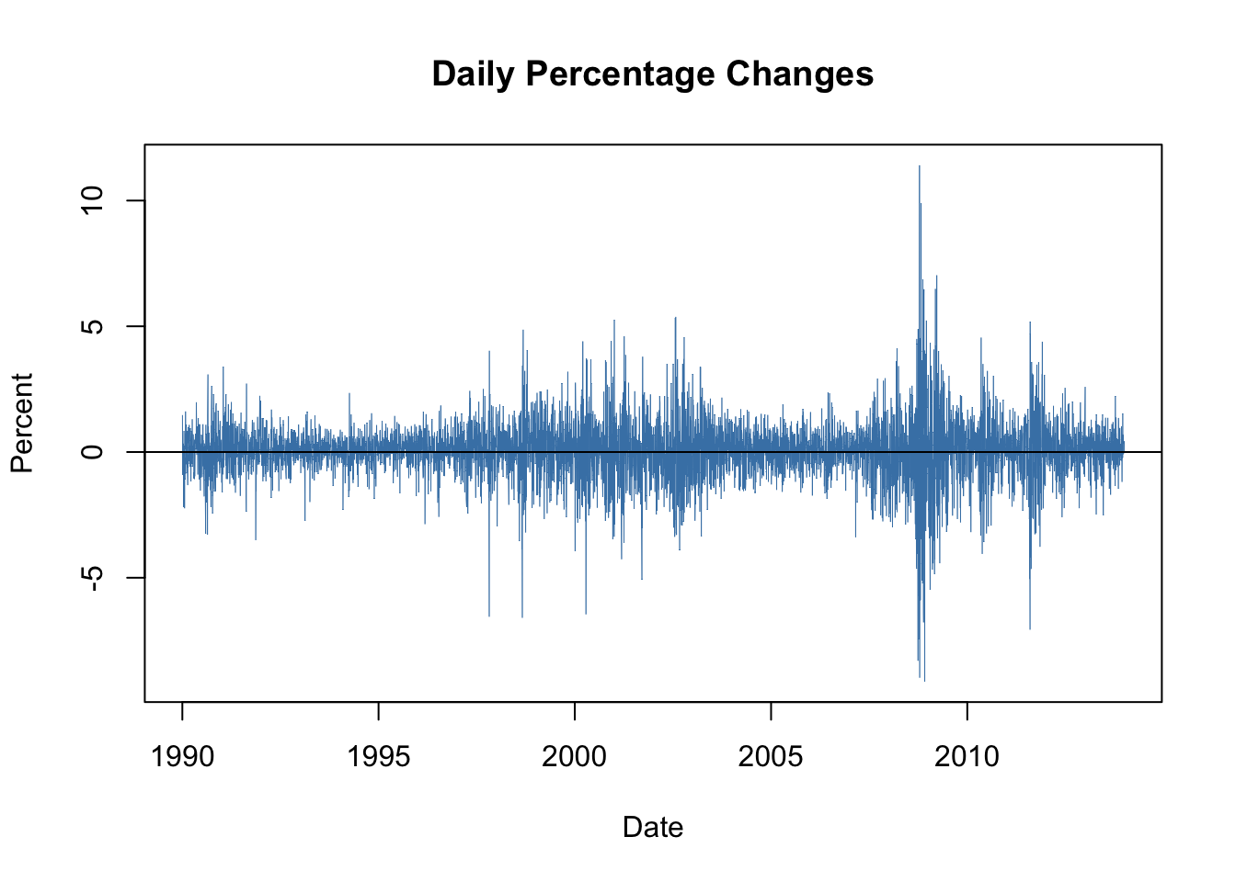

Slide 6
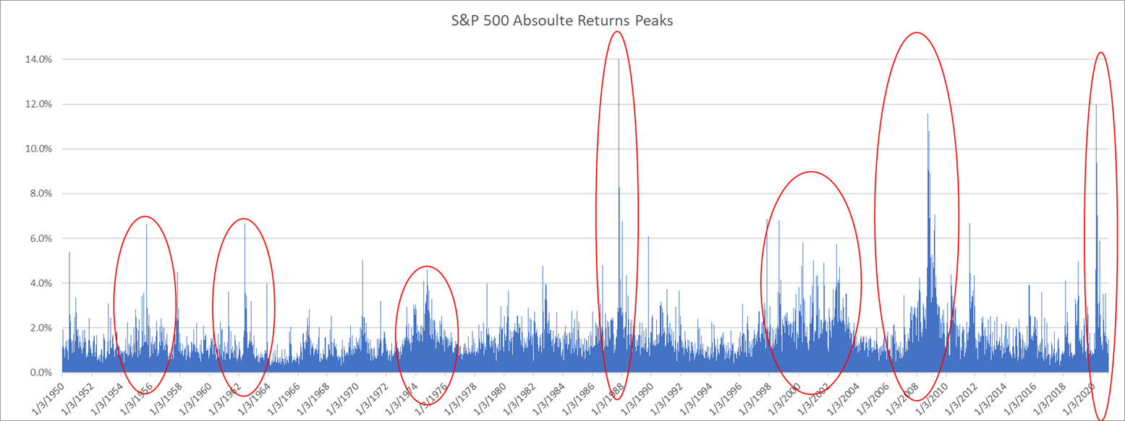

Slide 7

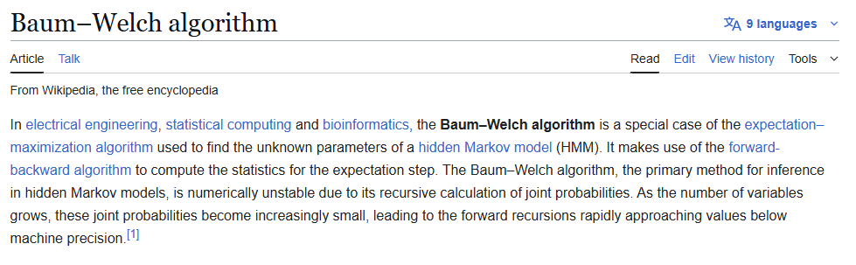
Youtube: djp3, Hidden Markov Models

Slide 8
rolling walk-forward with refitting.
Fit HMM on data up to time t
Forecast H-day variance
Compare with realized variance over [t+1,t+H]
Move forward by step
Refit the model

Slide 9
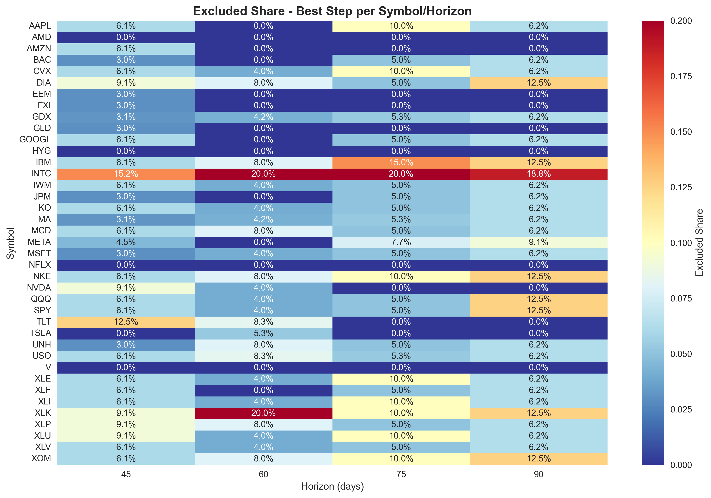


Slide 10
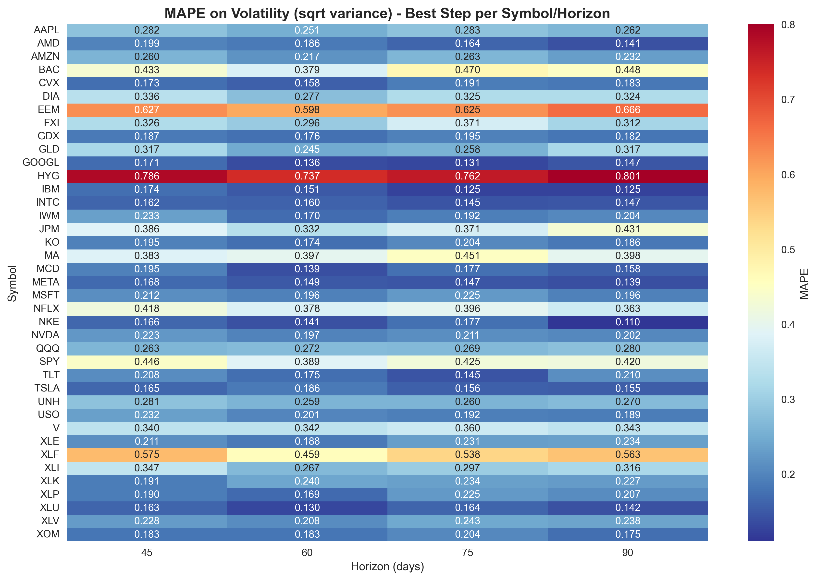


Slide 11
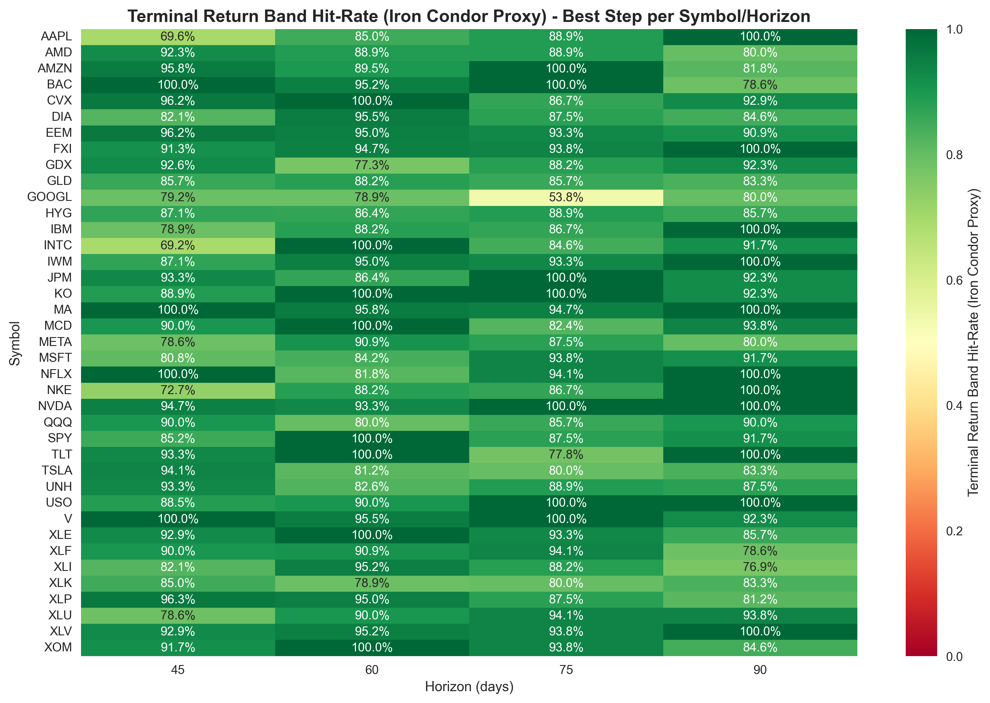

Slide 12
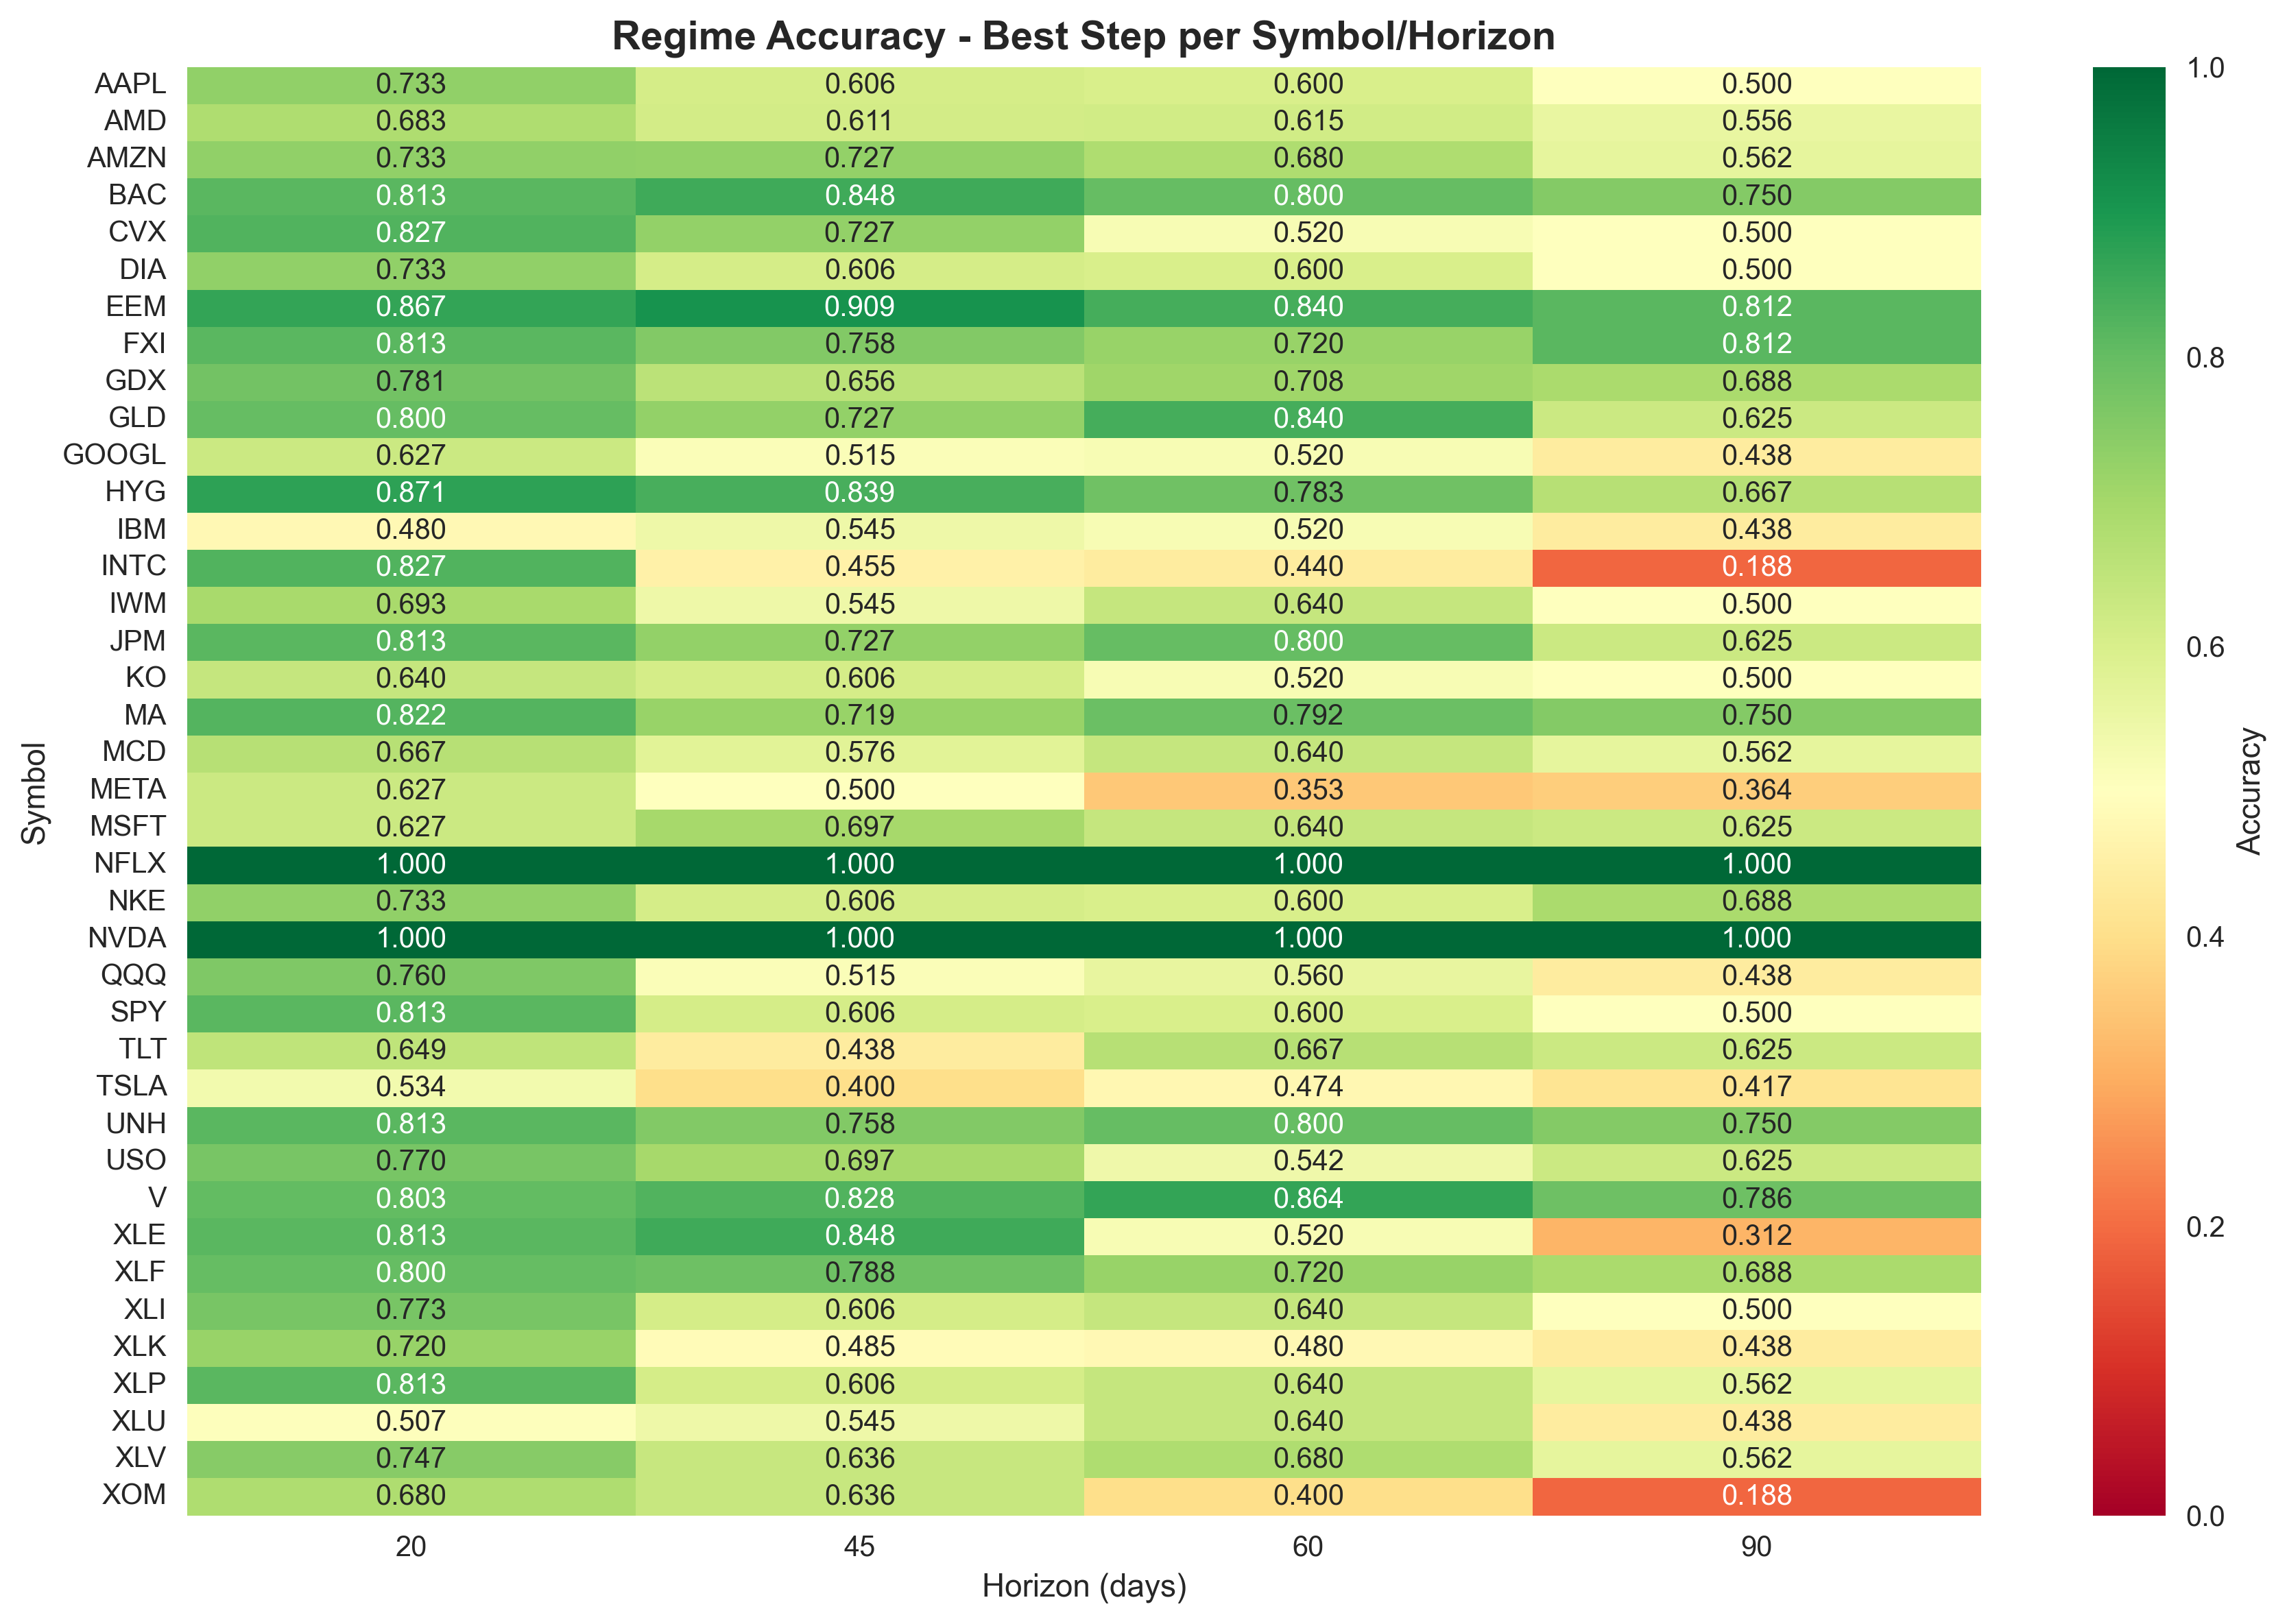

Viterbi algorithm

Slide 13
